Slide 1
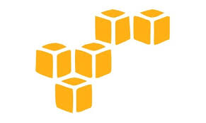
DevOps & Cloud Infrastructure SEIS 615 Virtualization & AWS
Jason Baker
Adjunct Instructor
Graduate Programs in Software
University of St. Thomas
St. Paul, MN

Slide 2
Agenda
Virtualization
Cloud Computing
Amazon Web Services (AWS)
IAM
S3
EC2

Slide 3
Virtualization
A stack: combination of infrastructure, OS, and applications required to support a service.
Before early 2000’s, a stack = 1 server + 1 OS
Software applications
Operating System
Compute/Storage

Slide 4
Virtualization
We can create software which emulates hardware.
Each emulated virtual system can have its own OS and set of applications.
Multiple stacks are logically partitioned from a process, memory, and networking perspective.

Slide 5
Virtualization solves problems
Servers become as easy to maintain as software.
It’s easier to move software around than physical servers.
No need to purchase a separate server for each user or team because virtualization provides partitioning.

Slide 6
Virtualization definitions
First, some definitions:
Host machine: physical server that supports multiple virtual machines.
Virtual machine: virtualized server instance running on a host machine (also known as an instance or a workload).
Host OS: operating system running on a bare-metal server.
Guest OS: operating system running on a virtual machine.
Hypervisor: Software that emulates and manages the communication between virtual machines and the physical server.

Slide 7
Virtualization Types
Hardware virtualization
Part of physical server dedicated to a specific stack.
Big expensive mainframe-type systems

Slide 8
Virtualization Types
Software virtualization
Two types available:
Type 1 Hypervisor
Runs on top of the bare-metal server and sits between hardware and operating systems in the stacks.
Examples: VMWare ESX, Microsoft Virtual Server, Xen
Type 2 Hypervisor
Runs on top of an operating system.
Easy installation (no special hypervisor or storage required).
Example: Oracle VirtualBox, VMWare Fusion

Slide 9
Type 1 vs. Type 2 Hypervisor

Slide 10
Virtualization Types
OS Partitioning
Host (or guest) operating system can partition out processes, memory, and scheduling to emulate a separate OS environment.
Separate OS environments all use same kernel.
If host is Linux then all “guests” are Linux.
Example: Docker containers
We will cover this later in the course. ☺

Slide 11
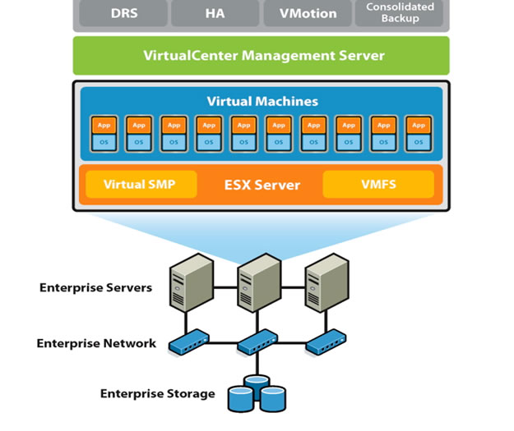
Virtualization infrastructure
Server virtualization is the predominant form of virtualized infrastructure.
Most servers in enterprises are now virtualized.
Gartner estimates up to 75% of workloads are virtualized.
New virtualization software licenses have declined for first time in over a decade!

Slide 12
Cloud Computing
What is cloud computing?
Cloud computing is a model for enabling convenient, on-demand network access to a shared pool of configurable computing resources (e.g., networks, servers, storage, applications, and services) that can be rapidly provisioned and released with minimal management effort or service provider interaction.
National Institute of Standards and Technology
NIST SP 800-145

Slide 13
Cloud Computing Characteristics
On-demand
Infrastructure available as needed via a self-service interface
Network access
Infrastructure accessed via a broad network (generally Internet)
Resource pooling
Infrastructure aggregated into large resource pools which are subsequently partitioned to support specific functions
Elasticity
Utility service
Ability to rapidly provision and de-provision services as needed
Pay-for-usage pricing model with no minimum commitments

Slide 14
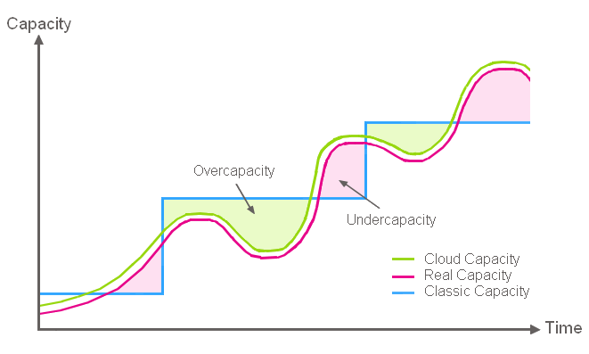
Cloud Computing Benefits
Align infrastructure capacity with current IT demand to achieve cost savings.

Slide 15
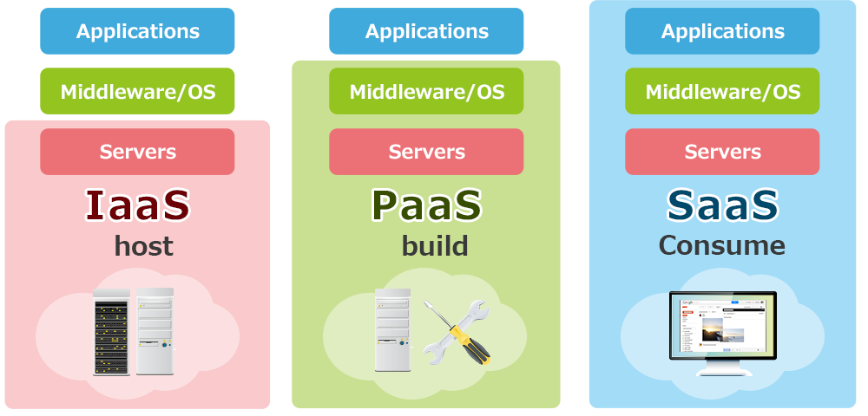
Cloud Computing Service Models
Infrastructure-as-a-Service
Platform-as-a-Service
Software-as-a-Service

Slide 16
Cloud Deployment Models

Slide 17
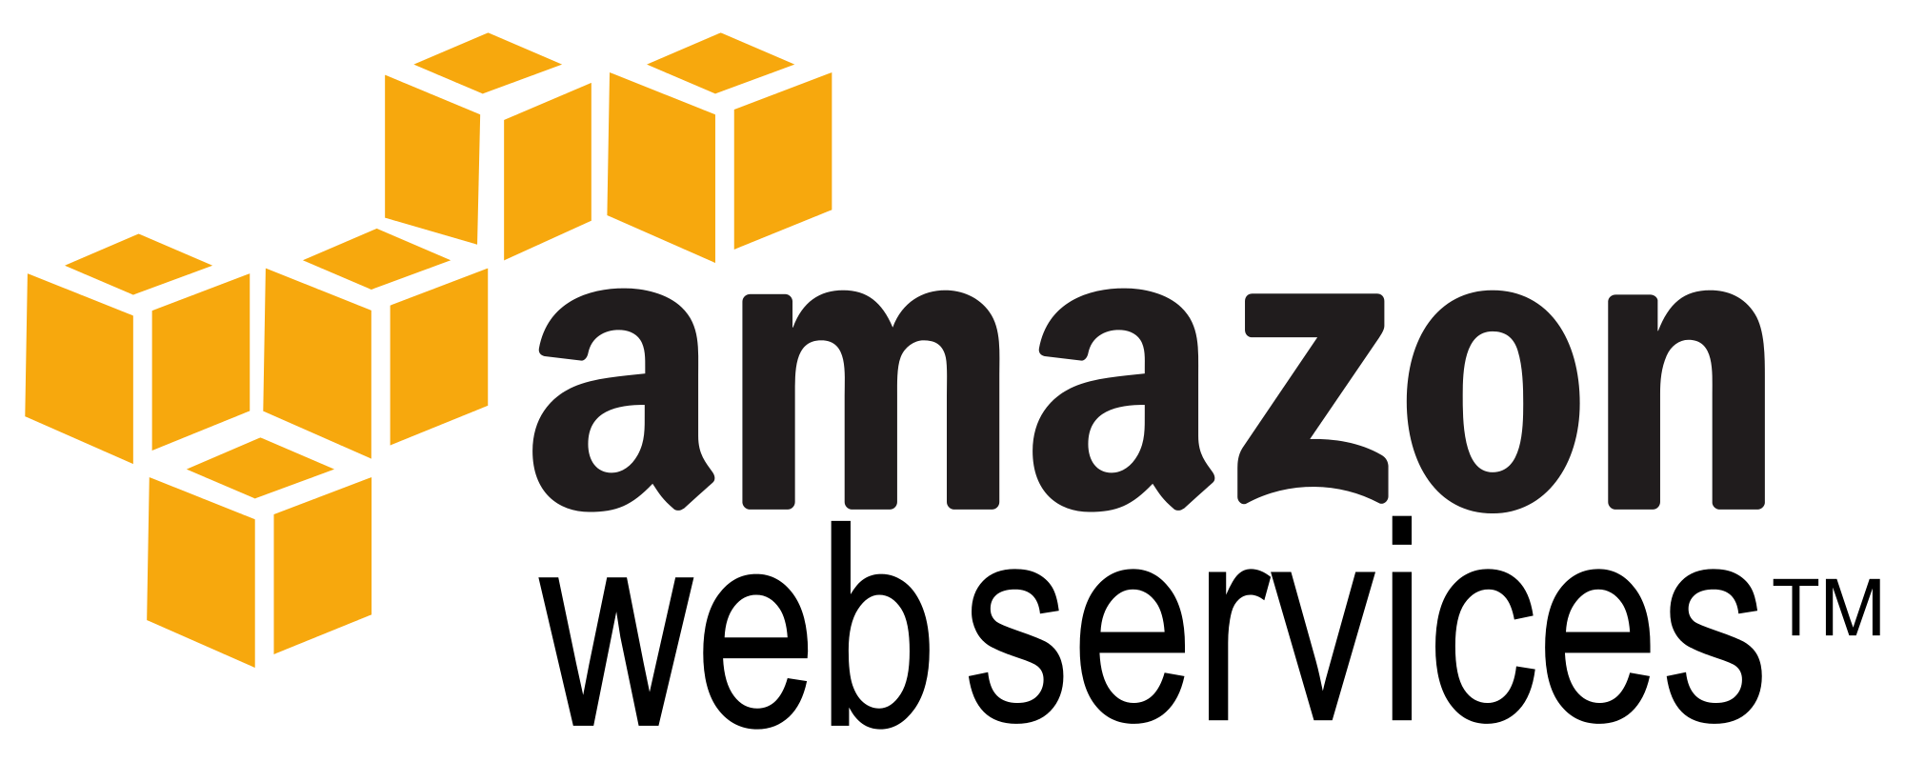
Amazon Web Services
1st public cloud computing platform
Chris Pinkman and Benjamin Black described what Amazon infrastructure should like and how it could be sold as a service.
Simple Queue Service (SQS) launched in 2004.
S3 & EC2 (AWS) launched in 2006.
Largest public cloud provider
AWS is larger than the next 3 largest cloud providers combined.
Amazon.com runs on top of AWS (though on completely separate infrastructure).

Slide 18
Why AWS?
AWS platform contains all of the services needed to reinforce concepts in this course.
IT professionals should understand how to use the most popular cloud platform.
Students receive educational credits for using AWS.
Course lectures based on AWS certification training paths.

Slide 19
AWS Ecosystem

Slide 20
Global Infrastructure

Slide 21
AWS Regions & Zones
AWS Infrastructure partitioned into many regions, each of which contains one or more availability zones (AZs).
Regions are in separate geographical locations around the world.
AZs represent distinct locations, comprised of one or more datacenters, within a particular region.
Availability zone IDs are an abstraction and will differ between customer accounts.
Region: us-east
Region: us-west
Availability Zone
Availability Zone
Availability Zone
Availability Zone
Availability Zone
Availability Zone

Slide 22

Identity & Access Management (IAM)
IAM allows organizations to create users and manage their access to AWS resources.
Provides granular governance controls and federated access.
Password expiration/strength
Login via Active Directory, Facebook, etc.
Restrict access to specific services and resources.
Signup account (root account) is your master account, best practice is to not use it for day-to-day management.

Slide 23
IAM Terms
User: an individual setup with an account in IAM.
Group: a set of users sharing similar access privileges.
Role: access privileges that may be assigned to AWS resources.
Lets resources act like users with specific privileges.
Policy: a document containing one or more defined privileges.

Slide 24

Hands-on
Log into the AWS Web Console using your account.
Try to follow the instructor on your own or work with a classmate.

Slide 25
IAM Hands-on
IAM is global, any changes we make impact all regions.
All activities we do on the web console may also be done via command line or SDK.
IAM users sign-in link is the web login URL for users (and it may be customized).
IAM Security Status shows important security steps (recommend turning on MFA).

Slide 26
IAM Hands-on
Create new user
Each user has a user name, password, access key ID, and secret access key.
User name and password required to log into web console.
Access key and secret access key required to use AWS API (** KEEP THESE SAFE!!)
Create a new group
Each group has one or more policies attached.
Policies define access privileges for group members.
Account Settings
Define password strength/expiration requirements.
Roles
Allow a resource to access other resources with set privileges.
Example: Allow webserver on EC2 to retrieve files stored on S3.

Slide 27

Simple Storage Service (S3)
Secure, durable, highly-scalable object storage
Object based and stored as a key/value + metadata
Key = filename
Value = data
Version ID = version of the file
Metadata = various descriptive information about the file
Standard S3 data is stored across multiple AZs in a region (11 9’s durability: 99.999999999%)
Highly available: 4 9’s availability (99.99%)
Unlimited storage
Individual files may be 0 bytes to 5TB
You cannot install a file system on S3 (ntfs/ ext4) or use for database storage!

Slide 28
S3
S3 storage namespace is partitioned into buckets in each region.
Files are stored in a bucket.
Bucket name is global and must be unique.
Initial limit of 100 buckets per account (but can be increased).
Data consistency
New objects = Read after Write consistency.
Updated or deleted objects = Eventual consistency.
If you update an object and then try to immediately read it again, you might get the old version.

Slide 29
S3
Security
Set access control policies on a bucket level or a per-file level.
Encrypt data-at-rest for greater security (AES-256).
Transmit data to S3 via SSL/TLS.
Create logs tracking all access to buckets and files.
Cost
Pay for storage space per GB, number of requests (GET, PUT, etc.) and data transmission.
No fee for incoming data.
Additional S3 features
Several storage classes for increased performance or lower cost.
Lifecycle management to automatically delete or archive data.
Versioning to track changes to file.

Slide 30
S3 Storage Classes
Standard S3: default storage tier appropriate for most requirements.
Durability: 99.999999999% (11 9’s)
Availability: 99.99% (four 9’s)
S3-IA (Infrequently Accessed): data which isn’t accessed frequently, but must be available immediately.
Availability: 99.9% (three 9’s)
S3-IA One Zone: data which isn’t accessed frequently, but must be available immediately and doesn't need to be resilient.
Availability: 99.5% (two 9’s)
Intelligent Tiering: monitors access to object and automatically moves it from standard to infrequent access tier (or vice-versa)
Glacier: inexpensive data archiving, minutes-to-hours (configurable) to restore data.
Deep Glacier: designed for archiving data 7+ years, retrieval of data within 12 hr

Slide 31
S3 Hands-on
Create a new bucket
Bucket name must be globally unique and associated with a specific region (don’t use this example name):
https://s3-us-east-1.amazonaws.com/ust123
Permissions: set bucket-level access policy.
Static website hosting: host a website using a set of files in a bucket.
Events: trigger notifications based on file changes.
Versioning: track file changes.
Lifecycle: automate file archiving or deletion.
Tags: create unique metadata for tracking

Slide 32
S3 Hands-on
Add a new file
Upload a file through web console.
File changes via HTTP PUT or DELETE.
Each file has a set of metadata.
Each file has a unique web link.
Can set storage class and encryption on a per-file basis.

Slide 33

CloudFront
Global Content Distribution Network (CDN)
Cache S3 files at over 50 edge locations throughout the world.
Edge location: physical datacenter location were files are stored.
Don’t confuse edge locations with regions!
Distribution: a set of S3 files that are cached in edge locations.
Benefit: Website visitor is automatically directed to closest file cache, decreasing download latency and improving website response time.
Note: it can be expensive to remove (invalidate) cached objects. Oftentimes people just add new versions of their files to the distribution.

Slide 34
CloudFront Edge Locations

Slide 35
S3 Transfer Acceleration

Slide 36

Snowball

Slide 37
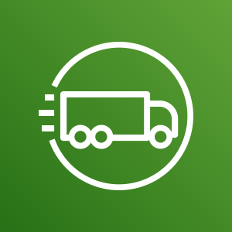
Snowmobile
100 Petabyte (PB) storage transfer!

Slide 38

Elastic Compute Cloud (EC2)
Service that provides resizable compute capacity in the cloud.
Core computing infrastructure building block that supports many other AWS services.
It’s basically a cloud-based virtual machine (AWS calls them instances) running on top of a customized Xen hypervisor.

Slide 39
EC2 Deployment Options
On Demand: pay a fixed rate for the EC2 instance on a per-second basis.
Short-term unpredictable workloads.
Customer controls start/termination because the application cannot be interrupted.
Reserved: reserve a certain amount of computing capacity for 1-to-3 years at a discounted rate.
Long-term, predictable workloads with known capacity requirements.
Convertible option: upgrade to bigger instance with no penalty
Spot: make a bid for computing capacity that’s not currently being used.
Very short-term workloads.
AWS may shutdown the instance at any time if the spot prices increases over the bid price.
Option to persist data after shutdown.

Slide 40
EC2 Instance Types
Type | Purpose
T2/ T3 | Low cost, general purpose computing, small app server or test/dev server
M4/ M5 | General purpose computing, typical application server
C4/ C5 | Compute optimized, CPU intensive applications
R4/ R5 | Memory optimized, in-memory caching or database systems
X1 | Large-scale in-memory systems
P2/ P3 | GPU-accelerated systems
G2 | Graphics optimized (GPU), video transcoding and machine learning
I3 | High speed storage optimized, database systems
H1/ D2 | Dense local storage system, file servers, Hadoop
* Easy way to compare instance features and pricing: http://www.ec2instances.info/

Slide 41
EC2 Amazon Machine Image (AMI)
You create an EC2 instance using an AMI (template).
An AMI defines the base OS, applications, networking and storage components for an EC2 instance.
AMI sources:
Amazon curated images
Community provided images
Commercial images on the Amazon Marketplace
Your own private images
AMIs only exist within a specific region (you can copy to other regions if necessary).

Slide 42

Elastic Block Storage (EBS)
Service that allows you to create disk storage volumes that can be attached to EC2 instances.
A volume is like a hard drive for your instance.
EBS volumes are block storage and support file systems and databases.
Each volume replicated within the AZ to provide high availability.
Its delivered like a volume from a SAN.
EC2 instance sees it as a physically attached drive.

Slide 43
EBS Volume Types
General Purpose SSD (gp2, gp3)
5 9’s availability (99.999%)
3 IOPS per GB, up to 16,000 IOPS/volume
Flexibly define IOPS (gp3)
Provisioned IOPS SSD (io1)
Very high IOPS capacity for disk I/O intensive applications requiring > 16,000 IOPS
Throughput Optimized HDD (st1)
Magnetic storage for streaming applications
Cold HDD (sc1)
Cheapest storage designed for infrequently accessed data

Slide 44
EBS Snapshots
A snapshot is a point-in-time copy of an EBS volume stored on S3.
Snapshots are incremental, only saving data that changed since the previous snapshot.
You pay for snapshot storage at S3 rates.
Benefits:
Quickly backup data periodically or before making big changes.
Roll back system changes by reverting to previous snapshots.
Notes:
Initial snapshots will take longer.
You should stop a root volume before taking a snapshot to ensure consistency.

Slide 45
Instance Store
Instance store is another data storage option for EC2 instances.
The original storage option!
Instance data is stored on a physical hard drive attached to the host server versus a networked volume.
The storage is ephemeral, if the instance is stopped the data is gone forever.
You can still reboot the instance without losing data though.
Why ephemeral storage?
Cheap
Data persistence may not matter in certain architectures.

Slide 46
EC2 User Data
User Data is a set of shell script commands automatically executed by the instance during the initial launch.
Commands are executed as root, therefore sudo is not needed.
Commands are supplied via text entry or stored in a file.
Benefit: automate installation and configuration of instance.

Slide 47
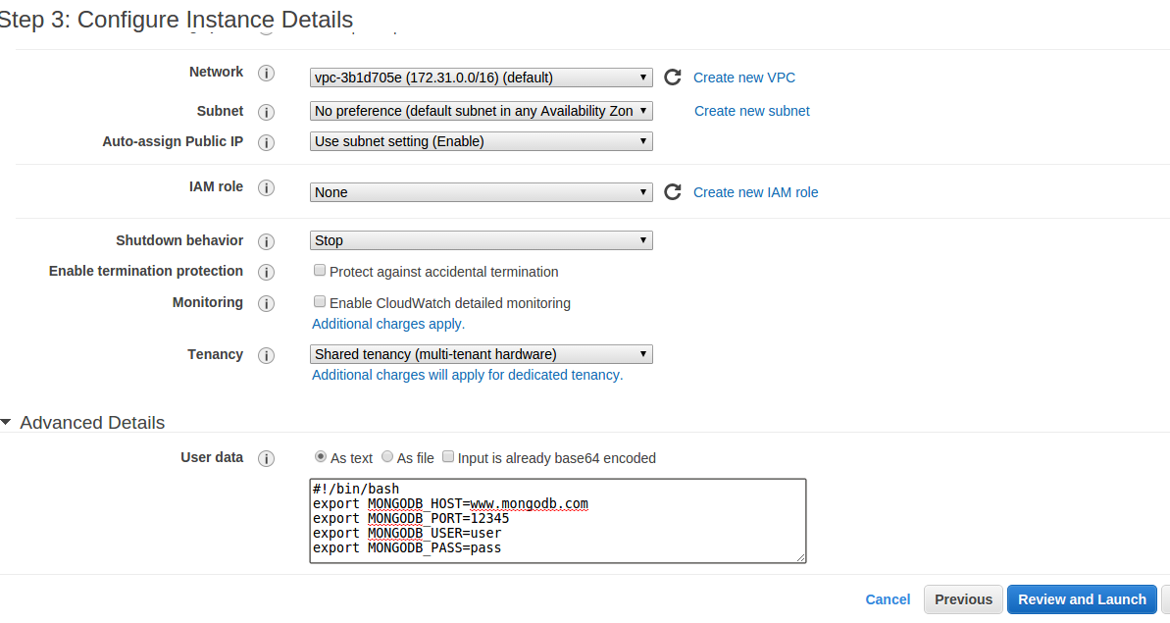
EC2 User Data

Slide 48
Security Groups
Security groups provide a security layer around EC2 instances.
Define a set of IP addresses and protocols that can send data to and from servers.
It’s like a basic layer-4 firewall system.
Default security group
All inbound traffic is blocked.
All outbound traffic is allowed.
Security groups are stateful meaning that responses from allowed connections are valid.
Server can initiate outbound web request and receive an inbound response even if port 80 (http) incoming traffic is blocked.

Slide 49
Security Groups
SG can contain any number of EC2 instances
An EC2 instance may be associated with up to 5 different security groups
0.0.0.0/0 represents “everywhere”
Web Security Group
DB Security Group
Instance
Instance
Instance
Instance
Instance
Instance
Incoming port 80 from 0.0.0.0/0
Incoming port 443 from 0.0.0.0/0
Outgoing any to 0.0.0.0/0
Incoming port 3306 from Web SG
Incoming port 22 from Web SG
Outgoing port 80 to Web SG
VPC

Slide 50
EC2 Placement Groups
Cluster placement group: A set of EC2 instances placed together in a single AZ to improve network performance.
Very low latency network access within a single AZ.
Only supports certain types of instances.
Instances in a placement group should be similar type and cannot merge placement groups.
High performance computing, Big data/ Hadoop
Spread placement group: A set of instances placed on distinct physical hardware hosts.
Ensure that certain business applications never run on the same physical servers.
Able to span multiple AZs.

Slide 51
EC2 Hands-on
Launch a new EC2 instance
Select an Amazon Linux AMI
Choose an instance type
Add/modify storage
Tag instance
Log into EC2 instance
Add a new security group (webservers)
Make sure ssh port is open in SG
Update server packages
Show instance meta-data capability:
curl http://169.254.169.254/latest/meta-data/
curl http://instance-data/latest/meta-data/
Show AWS CLI (aws help)
Snapshot instance volume
Create AMI from instance
Terminate EC2 instance

